Slide 1
Online Bookstore
Bookie.com

Slide 2
Introduction
Bookie.com is a web application to manage an online bookstore. This application helps to add, edit, delete, list & search books.
Backend is developed using Java & Spring Boot framework based on Controller-Service-Repository pattern. Frontend is developed using HTML, CSS, Thymeleaf & aided by Bootstrap & Font Awesome. Database is managed by MySQL.
Source code can be found at https://github.com/goutham-j/bookstore. Refer to the README.md file on instructions to deploy & run this application.

Slide 3
Requirements
Ability to display web pages to manage book operations
Ability to list all available books
Ability to add a book with book name, author name, price & available quantity.
Ability to delete a book
Ability to edit a book
Ability to search by a keyword on critical attributes (book name, author name or price)

Slide 4
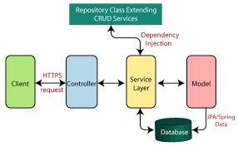
Design
Web Layer
Service Layer
Data Layer
Client
Browser (Chrome, IE)
Server

Slide 5
Data Definition
Fields | Program (Java) Class Book | Database (MySQL) Table - books
Book Identifier | Long id | `id` - int (Primary Key)
Book Name | String name | `name` - varchar(255)
Author Name | String author | `author` - varchar(255)
Price | double price | `price` - double
Available Quantity | int quantity | `quantity` - int

